Slide 1
System Process Modeling
DATA Flow Diagrams

Slide 2
System Models
System models play an important role in systems development.
Systems analysts or users constantly deal with unstructured problems.
One way to structure such problems is to draw models.
    A model is a representation of reality. Just as a picture is worth a thousand words, most system models are pictorial representations of reality.

Slide 3
What is Process Modeling?
Process modeling is a technique for organizing and documenting the structure and flow of data through a system’s processes.
  A business user, when questioned will usually focus on the processes of that operation.
  A process may be defined as an action or series of actions which produce a change or development.
The process view of a system may be modeled by a Data Flow Diagram

Slide 4
A data flow diagram (DFD) is a “graphical representation of the flow of data through a system” (Martin, 1995)
Data Flow Diagram
Graphical descriptions of the sources and destinations of data. They show:
  Where data comes from
  How it flows
  The processes performed on it
  Where it goes

Slide 5
DATA FLOW DIAGRAMS
A data flow diagram (DFD) graphically describes the flow of data within an organization. It is used to:
  Document existing systems
  Plan and design new systems
An ERD is a data model, and a DFD is a process model

Slide 6
DATA FLOW DIAGRAMS
A data flow diagram consists of four basic elements:
  Data sources and destinations. Also called external entities
  Data flows
  Processes
  Data stores

Slide 7
DATA FLOW DIAGRAMS
Data sources and destinations (External entities)
  Appear as squares
  Represent organizations, individuals, or organizational units that send or receive data used or produced by the system
An item can be both a source and a destination
Used to define system boundaries
Named with a noun

Slide 8
DATA FLOW DIAGRAMS
Data flows
  Appear as arrows, named with nouns
  Represent the flow of data between sources and destinations, processes, and data stores
  A data flow can be used to represent the creation, reading, deletion, or updating of data in a file or database (data store).
  At least one end of every data flow should either come from or go to a process.

Slide 9
DATA FLOW DIAGRAMS
If two data elements flow together, then the use of one data flow line is appropriate.
Process
Payment
Customer
Cash Rec’t & Remittance Slip

Slide 10
DATA FLOW DIAGRAMS
If the data elements do not always flow together, then multiple lines will be needed.
Process
Payment
Customer
Customer Inquiry
Customer Payment

Slide 11
DATA FLOW DIAGRAMS
Processes
  Appear as circles
  Represent the transformation of data
  Must be numbered and labeled with a single action verb and an object
  Avoid the use of the word “and” in the process name

Slide 12
DATA FLOW DIAGRAMS
The processes are shown in red.
Every process must have at least one data inflow and at least one data outflow.
Accounts
Receivable
Customer
Customer
payment
1.0
Process
Payment
Remittance
data
2.0
Update
A/R
Receivables
Information
Credit
Manager
Deposit
Bank

Slide 13
DATA FLOW DIAGRAMS
Data stores
  Appear as two horizontal lines, named with a noun
  Represent a temporary or permanent data repository
  Flow out of a data store = retrieval
  Flow into a data store = inserting or updating
  Data stores on a DFD are related to entities on an ERD

Slide 14
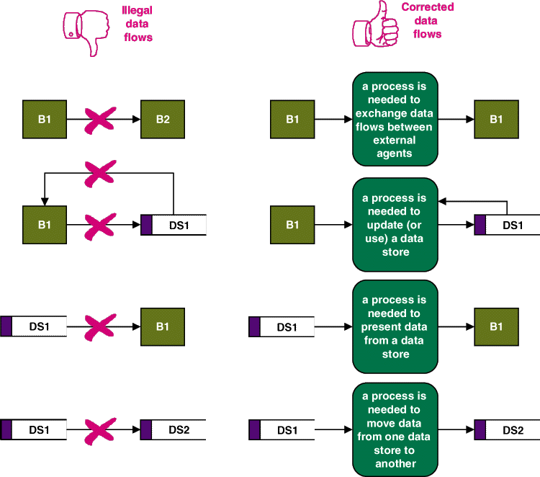
Notes:
No additional notes

Slide 15
DATA FLOW DIAGRAMS
Subdividing the DFD:
  Few systems can be fully diagrammed on one sheet of paper, and users have needs for differing levels of detail.
  Consequently, DFDs are subdivided into successively lower levels to provide increasing amounts of detail.
  Some data inputs and outputs will not appear on the higher levels of the DFD but appear as the processes are exploded into greater levels of detail.

Slide 16
DATA FLOW DIAGRAMS
The highest level of DFD is called a context diagram.
  It provides a summary-level view of the system.
  It depicts a data processing system and the external entities that are:
    Sources of its input
    Destinations of its output
  The process symbol is numbered with a “0”

Slide 17
DATA FLOW DIAGRAMS
Govt.
Agencies
Depart-
ments
Tax report & payment
Time cards
Payroll
Processing
System
Employees
0
Employee checks
New employee form
Payroll check
Bank
Human
Resources
Employee change form
Payroll report
This is the context diagram for the S&S payroll processing system (Figure 3-5 in your textbook).
Manage-
ment

Slide 18
DATA FLOW DIAGRAMS
A Level 0 diagram is a projection of the process on the Context diagram. It is like opening up that process and looking inside to see how it works – to show the internal sub-processes
On a Level 0 diagram, you repeat the external entities but you also expand the main process into its subprocesses. Also data stores will appear at this level.
The Level 0 diagram must “balance” with the Context diagram. This means they should both have the same external entities with the same flows to and from those entities.

Slide 19
DATA FLOW DIAGRAMS
Depart-
ments
Employees
Employee
checks
Human
Resources
New employee
form
Time
cards
1.0
Update
empl.
Payroll
file
2.0
Pay
Employ-
ees
Employee
Change
form
Payroll
check
Bank
Payroll
Disburse-
ment data
3.0
Prepare
reports
Employee/
Payroll file
5.0
Update
Gen.
Ledger
This diagram shows the next level of detail for the context diagram in Figure 3-5.
Payroll tax
disb. voucher
Payroll
report
4.0
Pay
taxes
General
Ledger
Manage-
ment
Tax report
& payment
Govt.
Agencies

Slide 20
DATA FLOW DIAGRAMS
Depart-
ments
Employees
Employee
paychecks
Human
Resources
New employee
form
Time
cards
1.0
Update
empl.
Payroll
file
2.0
Pay
Employ-
ees
Employee
Change
form
Payroll
check
Bank
Suppose we exploded Process 2.0 (pay employees) in the next level. The sub-processes would be numbered 2.1, 2.2, 2.3, etc.
Payroll
Disburse-
ment data
3.0
Prepare
reports
Employee/
Payroll file
5.0
Update
Gen.
Ledger
Payroll tax
disb. voucher
Payroll
report
4.0
Pay
taxes
General
Ledger
Manage-
ment
Tax report
& payment
Govt.
Agencies

Slide 21
DATA FLOW DIAGRAMS
A Level 1 diagram is a projection of a Level 0 process.
A Level 1 diagram shows all the processes that comprise a single process on the level 0 diagram.
It shows how information moves from and to each of these processes.
Level 1 diagrams may not be needed for all Level 0 processes.
On Level 1 diagrams we do not repeat external entities. Data stores may not be repeated either.

Slide 22
CONTEXT DIAGRAM
KITCHEN
CUSTOMER
0
Customer Order
Food Order
Food
Ordering
System
Receipt
Management
Report
RESTAURANT
MANAGER

Slide 23
LEVEL 0 DIAGRAM
KITCHEN
CUSTOMER
1.0
Customer Order
Food Order
Transform
Customer
Food Order
Receipt
3.0
2.0
Update
Goods Sold
Update
Inventory
Goods
Sold Data
Inventory
Data
Formatted
Inventory Data
Formatted Goods
Sold Data
D2
INVENTORY
D1
GOODS SOLD
Daily Inventory
Depletion Amounts
Daily Goods
Sold Amounts
4.0
Produce
Management
Report
RESTAURANT
MANAGER
Management
Report

Slide 24
DFD Balance
KITCHEN
CUSTOMER
Customer Order
1.0
Food Order
Receipt
Transform
Customer
Food Order
3.0
2.0
Update
Goods Sold
Update
Inventory
Goods
Sold Data
Inventory
Data
Formatted
Inventory Data
Formatted Goods
Sold Data
D2
INVENTORY
D1
GOODS SOLD
Daily Inventory
Depletion Amounts
Daily Goods
Sold Amounts
4.0
Produce
Management
Report
Management
Report
RESTAURANT
MANAGER

Slide 25
Level 1 Diagram
PROCESS 1 ON
THE LEVEL 0
DIAGRAM
SUB PROCESS 1
THIS LEVEL 1
DIAGRAM
1.1
1.3
Process
Customer
Order
Transform
Order to
Kitchen
Format
Customer Order
Customer Order
Food Order
Inventory
Data
Customer Order
1.5
Customer
Order
Generate
Inventory
Decrements
Customer Order
1.4
1.2
Generate
Good Sold
Increments
Generate
Customer
Receipt
Goods Sold Data
Receipt
NOTE HOW WE HAVE THE SAME INPUTS
AND OUTPUTS AS THE ORIGINAL PROCESS
SHOWN IN THE LEVEL 0 DIAGRAM

Slide 26
Another Level 1 Diagram
Daily Goods
Sold Amounts
4.0
Daily Inventory
Depletion Amounts
ORGINAL
LEVEL 0
PROCESS
Produce
Management
Report
Management
Report
Daily Inventory
Depletion Amounts
LEVEL 1 PROCESSES
4.1
Inventory Data
4.2
Daily Goods
Sold Amounts
Access
Goods Sold
and Inventory
Data
Aggregate
Goods Sold
and Inventory
Data
Goods Sold Data
4.3
Management
Report
Prepare
Management
Report
PROCESSES 2.0 AND 3.0 ON THE LEVEL 0 DIAGRAM
DO NOT NEED FURTHER DECOMPOSTION

Slide 27
DATA FLOW DIAGRAMS
Let’s step through some guidelines on how to create a DFD.
RULE 1: Understand the system. Observe the flow of information and interview people involved to gain that understanding.
RULE 2: Ignore control processes and control actions (e.g., error corrections). Only very critical error paths should be included.
RULE 3: Determine the system boundaries—where it starts and stops. If you’re not sure about a process, include it for the time being.

Slide 28
DATA FLOW DIAGRAMS
RULE 4: Draw the context diagram first, and then draw successively greater levels of detail.
RULE 5: Identify and label all data flows.
RULE 6: Data flows that always flow together should be grouped together. Those that do not flow together should be shown on separate lines.
RULE 7: Show a process (circle) wherever a data flow is converted from one form to another. Likewise, every process should have at least one incoming data flow and at least one outgoing data flow.

Slide 29
DATA FLOW DIAGRAMS
RULE 8: Processes that are logically related or occur simultaneously can be grouped in one process.
RULE 9: Number each process sequentially. A process labeled 5.0 would be exploded at the next level into processes numbered 5.1, 5.2, etc. A process labeled 5.2 would be exploded into 5.2.1, 5.2.2, etc.
RULE 10: Process names should include action verbs, such as update, prepare, etc.

Slide 30
DATA FLOW DIAGRAMS
RULE 11: Identify and label all data stores.
RULE 12: Identify and label all sources and destinations. An entity can be both a source and destination. You may wish to include such items twice on the diagram, if needed, to avoid excessive or crossing lines.
RULE 13: As much as possible, organize the flow from top to bottom and left to right.

Slide 31
DATA FLOW DIAGRAMS
RULE 14: You’re not likely to get it beautiful the first time, so plan to go through several iterations of refinements.
RULE 15: On the final copy, lines should not cross. On each page, include:
  The name of the DFD
  The date prepared
  The preparer’s name

Slide 32
DATA FLOW DIAGRAMS
The first paragraph of the narrative for the payroll process reads as follows:
  When employees are hired, they complete a new employee form. When a change to an employee’s payroll status occurs, such as a raise or a change in the number of exemptions, human resources completes an employee change form. A copy of these forms is sent to payroll. These forms are used to create or update the records in the employee/payroll file and are then stored in the file. Employee records are stored alphabetically.

Slide 33
DATA FLOW DIAGRAMS
Depart-
ments
Employees
Employee
paychecks
Human
Resources
New employee
form
Time
cards
1.0
Update
empl.
Payroll
file
2.0
Pay
Employ-
ees
Employee
Change
form
Payroll
check
Bank
Payroll
Disburse-
ment data
3.0
Prepare
reports
Employee/
Payroll file
5.0
Update
Gen.
Ledger
Payroll tax
disb. voucher
Payroll
report
4.0
Pay
taxes
General
Ledger
Manage-
ment
Tax report
& payment
Govt.
Agencies

Slide 34
DATA FLOW DIAGRAMS
The data flow diagram focuses on the logical flow of data.

